Slide 1
The FINAL EXAM JS Framework React AziLex CINEMA
Created by: Aleksandr Kim Azimbek Abdipattaev
Checked by: Yerlan Karabaliyev
INFT3139, Autumn 2022

Slide 2
Plan/Milestones
Milestone 1: 1. Description of the project 2. Responsibilities of the team 3. At least 4 pages 4. Components, Props
Milestone 2: Components, State, API Requests
Milestone 3: Navigation, Context System

Slide 3

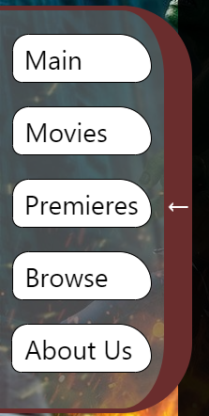
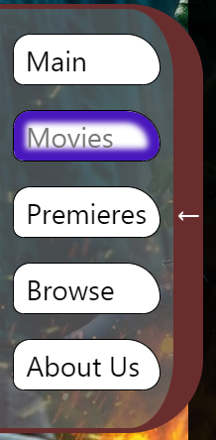
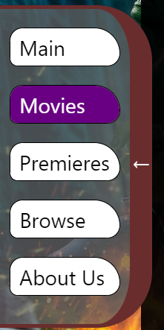
Milestone 1
AziLex cinema was created by Alexander Kim and Azimbek Abdipattaev
Description: On our AziLex website, you can keep track of news and trends in the film industry and animated cartoons. There are reviews of all films of all genres for all ages, from children to adults
The main goal of our project is to show our clients the descriptions and ratings of films
We created 8 components, 5 pages, a lot of functions and props.
CSS and animation(left navigation) are also applied.

Slide 4
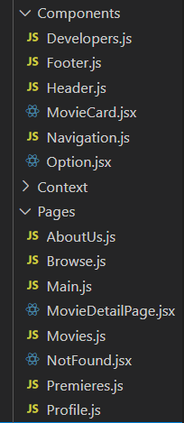
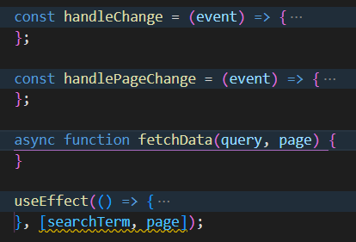
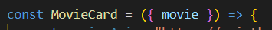
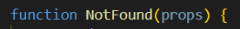
Milestone 1
Responsibilities:
Azimbek –Header, Browse, Main, Movies, Premieres;
Aleksandr – Navigation, Footer, Developers, AboutUs, Main.

Slide 5
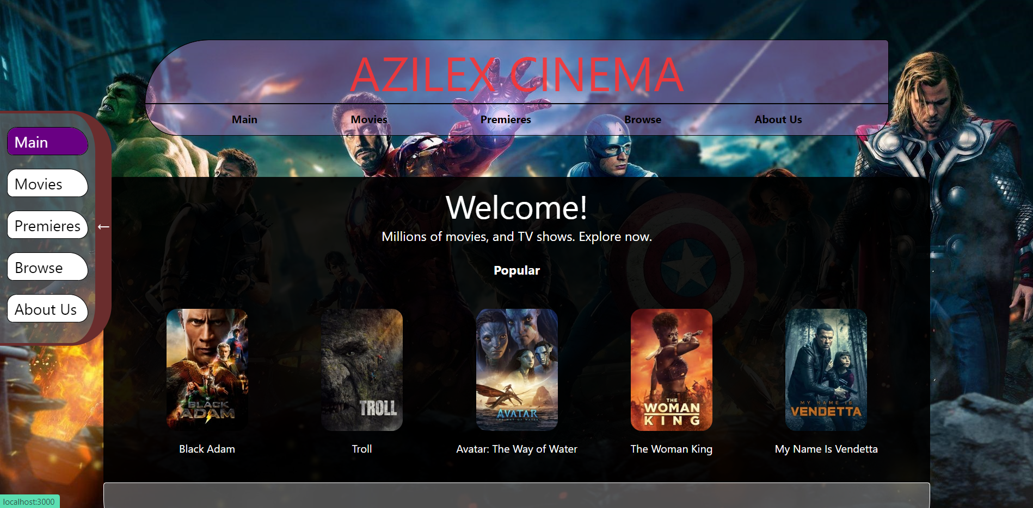
Milestone 2 Main
On the Main page you will be provided with a selection of the best and most popular films.

Slide 6
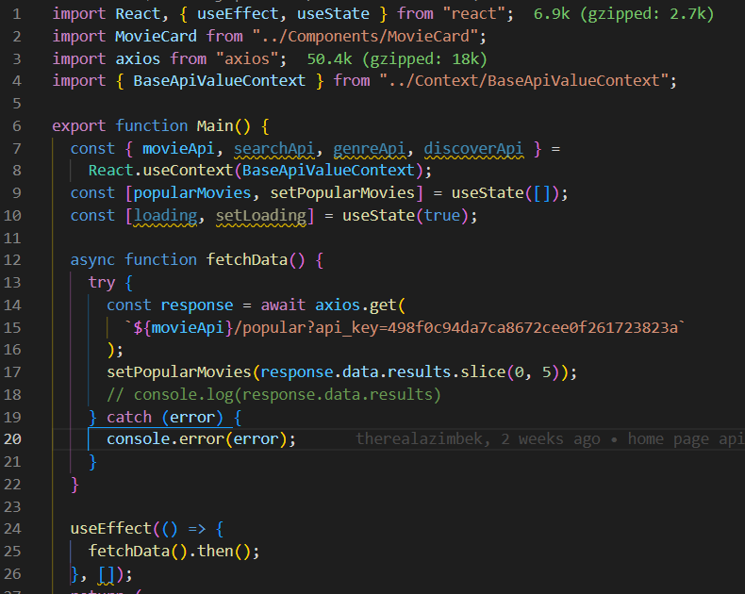
Milestone 2 Main code

Slide 7
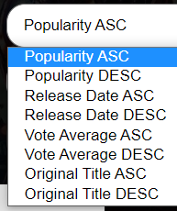
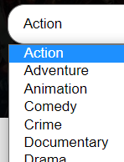
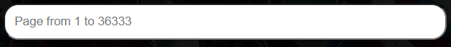
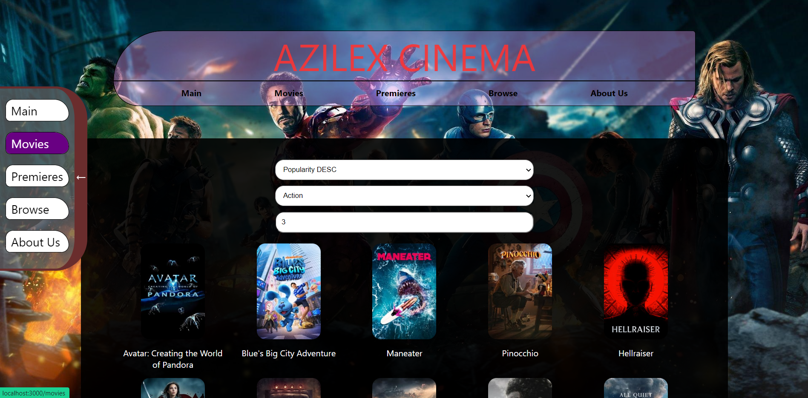
Milestone 2 Movies
On the Movies page you can view a list of movies. You can sort the list in ascending order, categories and genres, and there is also page numbering.

Slide 8
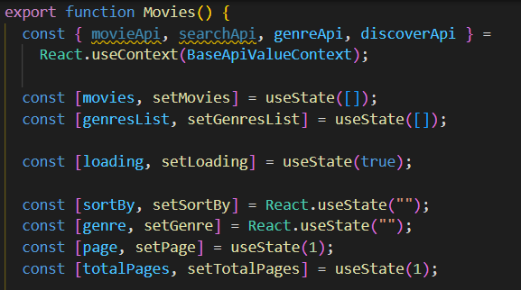
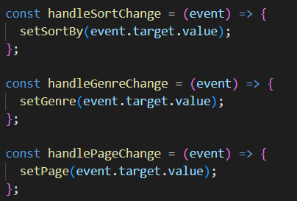
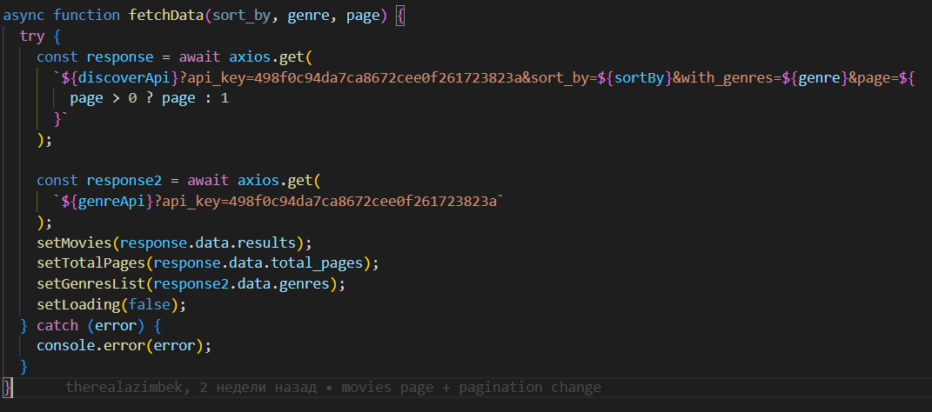
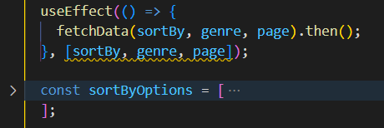
Milestone 2 Movies code

Slide 9
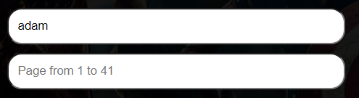
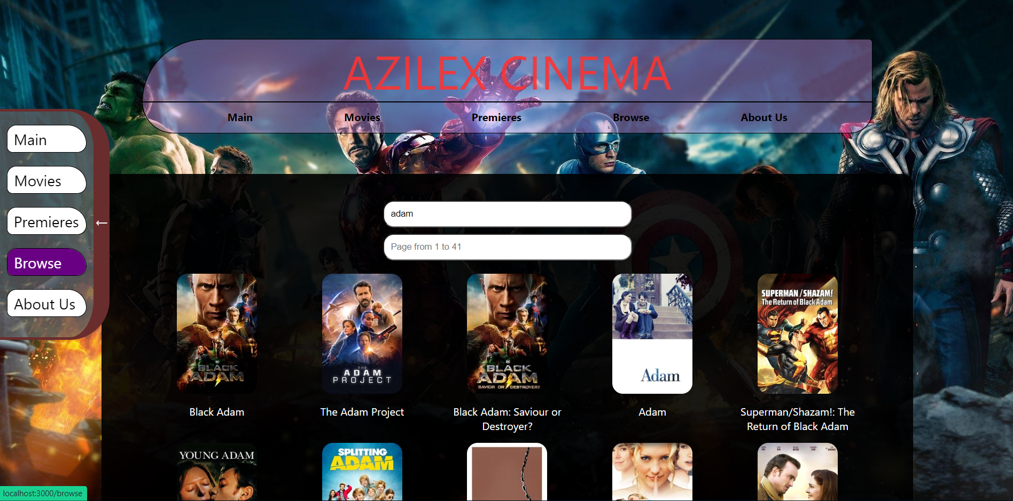
Milestone 2 Browse
On the Browse page, you can find a movie by name, and the number of pages of found movies is also displayed.

Slide 10
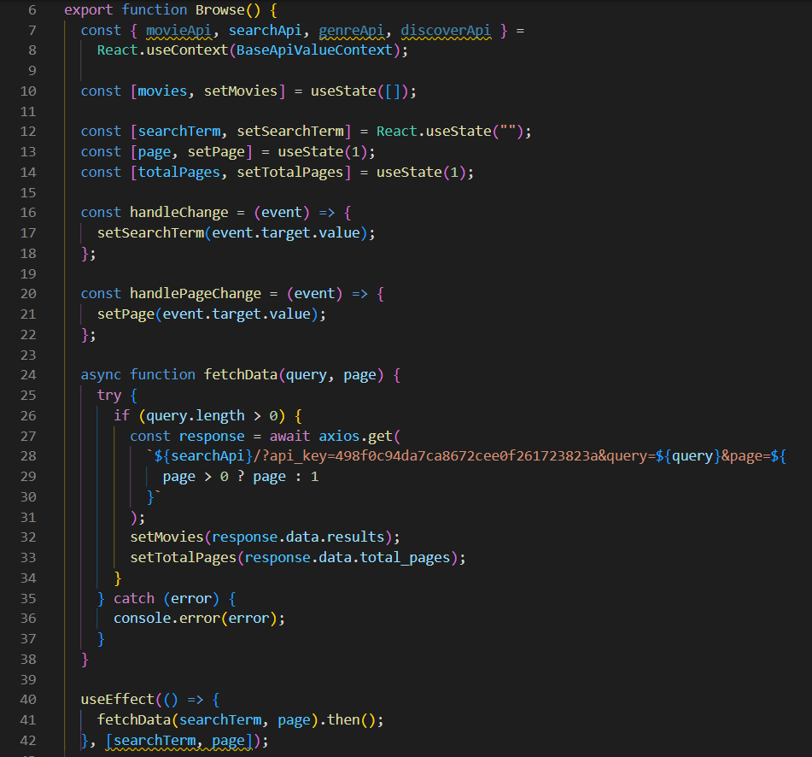
Milestone 2 Browse code

Slide 11
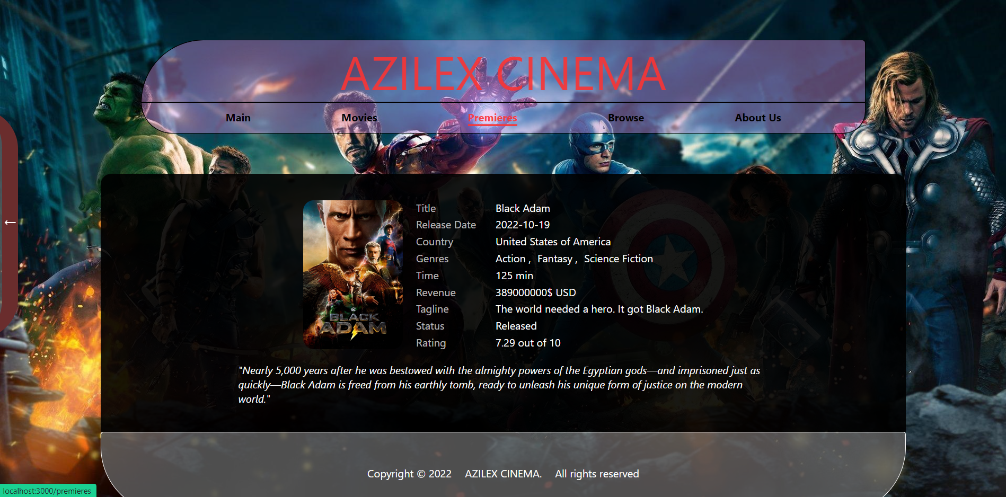
Milestone 2 Movie Detail page
If you click on the movie, we can see more detailed information about the movie we are interested in.

Slide 12
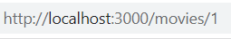
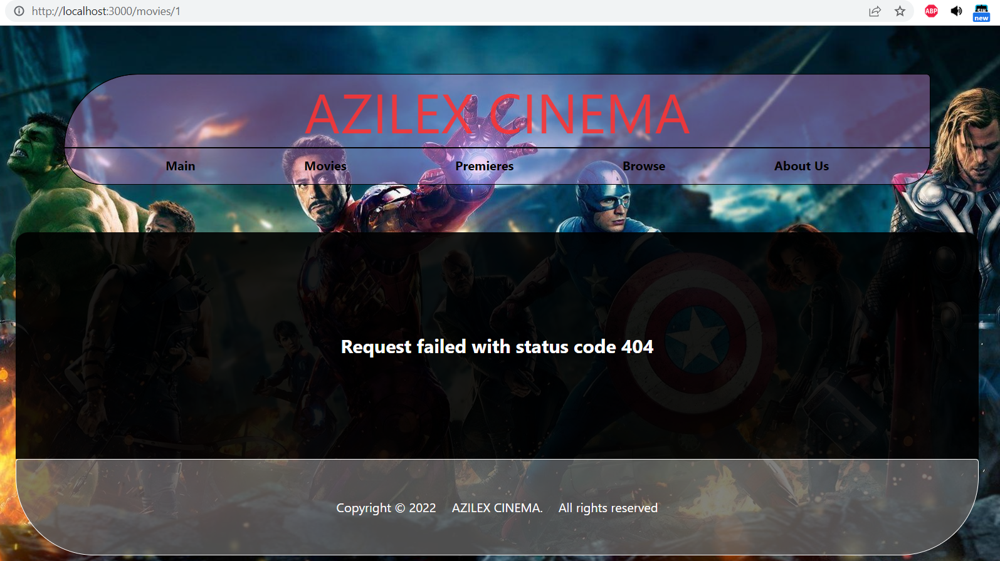
Milestone 2 / ERROR 404
If you click on a non-existent page, we will see an error. Request failed with status code 404

Slide 13
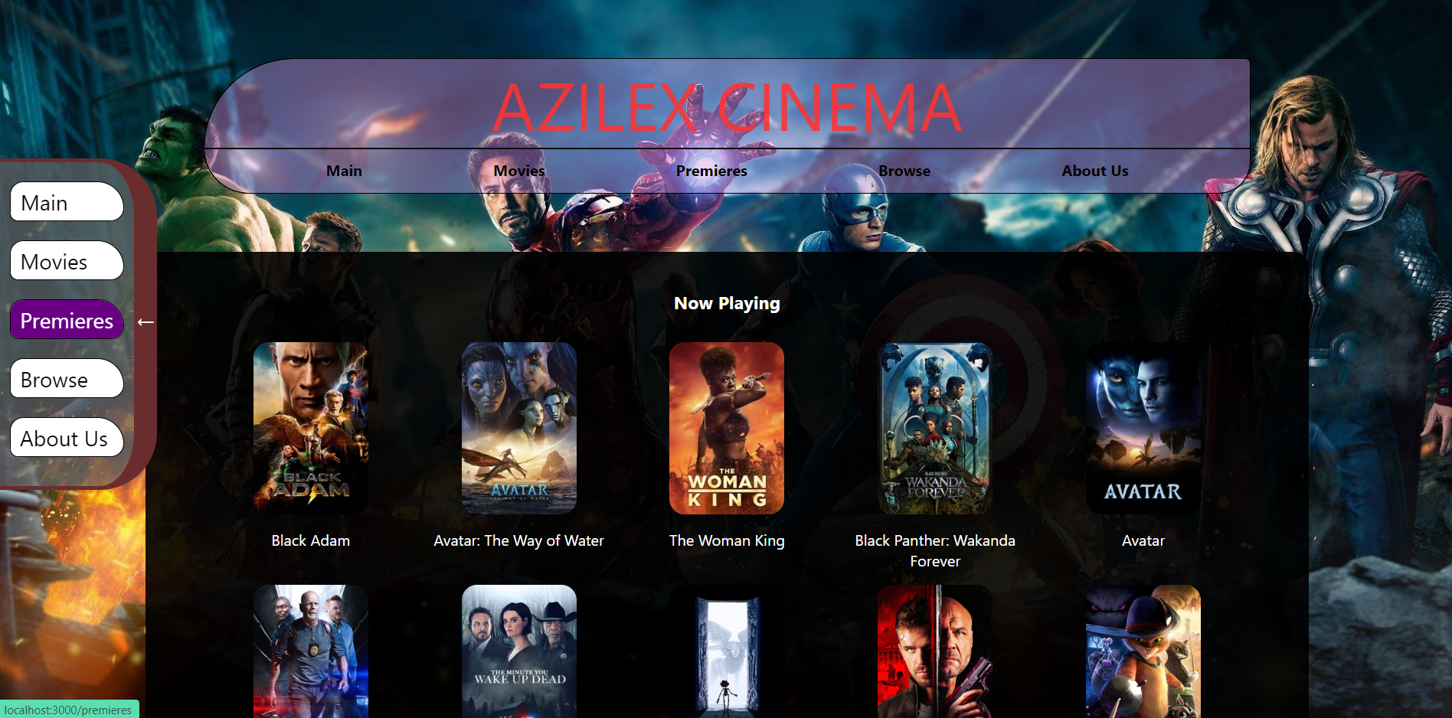
On the Premieres page, you will be provided with a list of current premieres and new films
Milestone 2 Premieres

Slide 14
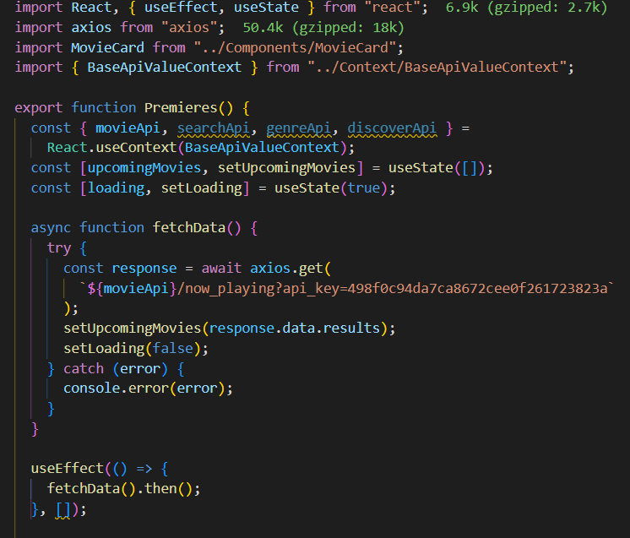
Milestone 2 Premieres code

Slide 15
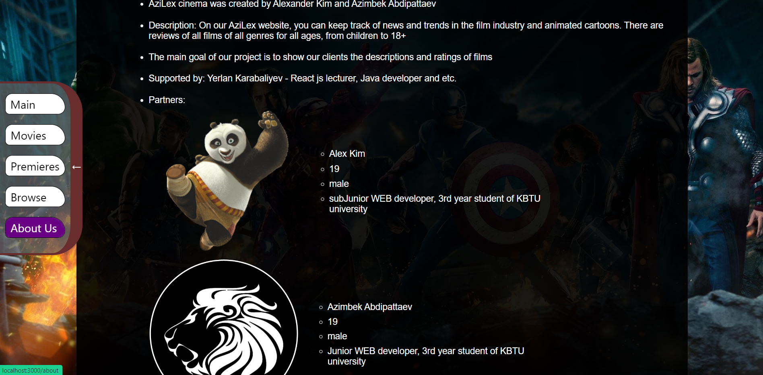
On the About Us page, you will be provided with brief information about the goals of our project, as well as about the creators and partners.
Milestone 2 About Us

Slide 16
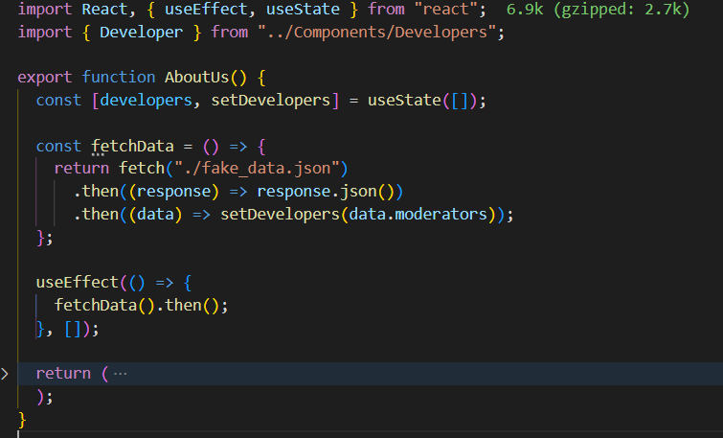
Milestone 2 About Us code
In many components we used axios, but this is enough to fetch from the local fake_data.json file

Slide 17
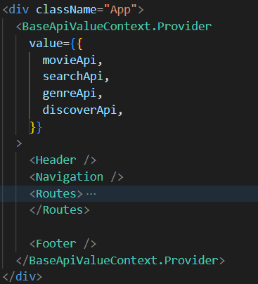
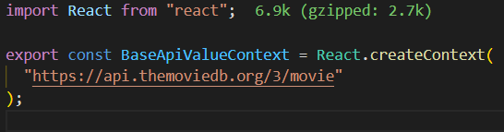
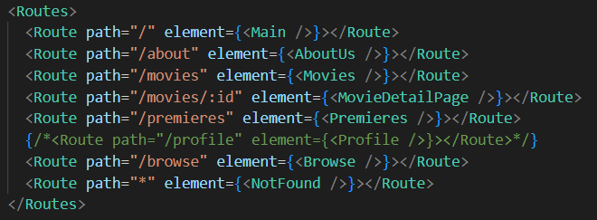
Milestone 3
We took a ready-made backend and used its API from an online source
Also we used React.createContext()
We did the navigation using Link, react and react-router-dom

Slide 18
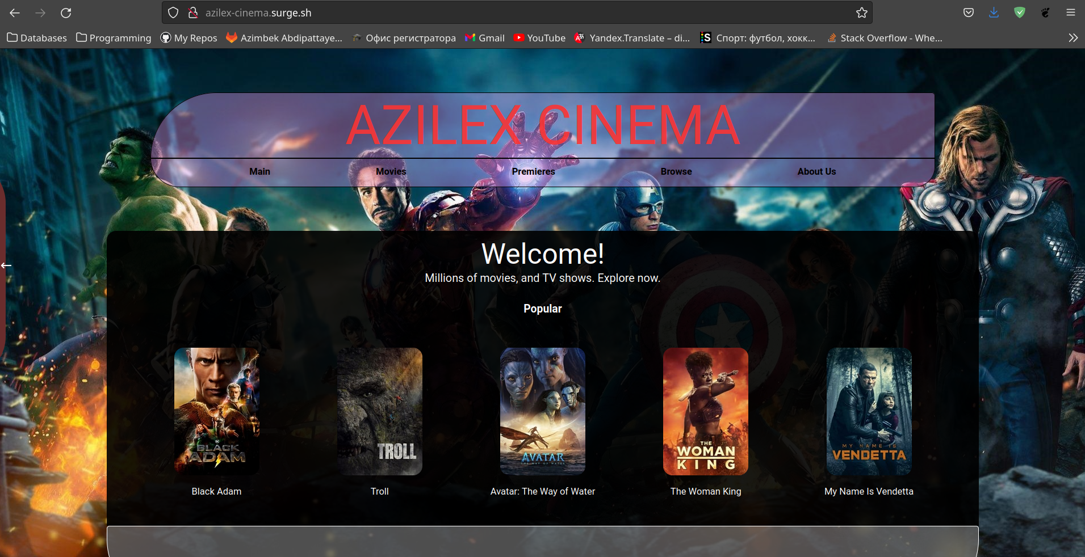
Link to the page
http://azilex-cinema.surge.sh/
Please access the web page with http only (not https)

